Slide 1
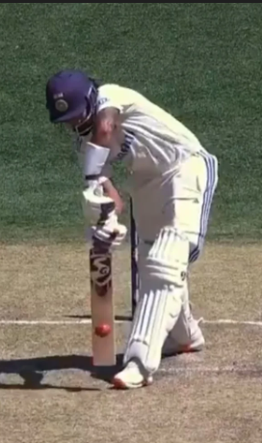
Cricket Shot Classification
& Similarity Detection
Deep Learning–Based Video Analytics for Cricket

Slide 2
Motivation Behind the Project.
Manual video analysis is slow, labor-intensive, and prone to human bias, making it unsuitable for large-scale or real-time applications.
This project aims to automate the interpretation of video content using deep learning, enabling machines to extract context, detect actions, and generate insights directly from visual data.
Key motives:
Eliminate manual labeling and subjective interpretation.
Achieve real-time, scalable video understanding.
Improve accuracy, consistency, and efficiency in visual analytics.
Enable data-driven decision-making across diverse fields—security, surveillance, industry, media, and beyond.
Goal: Transform unstructured video footage into structured, intelligent information through deep learning–based automated analysis.

Slide 3
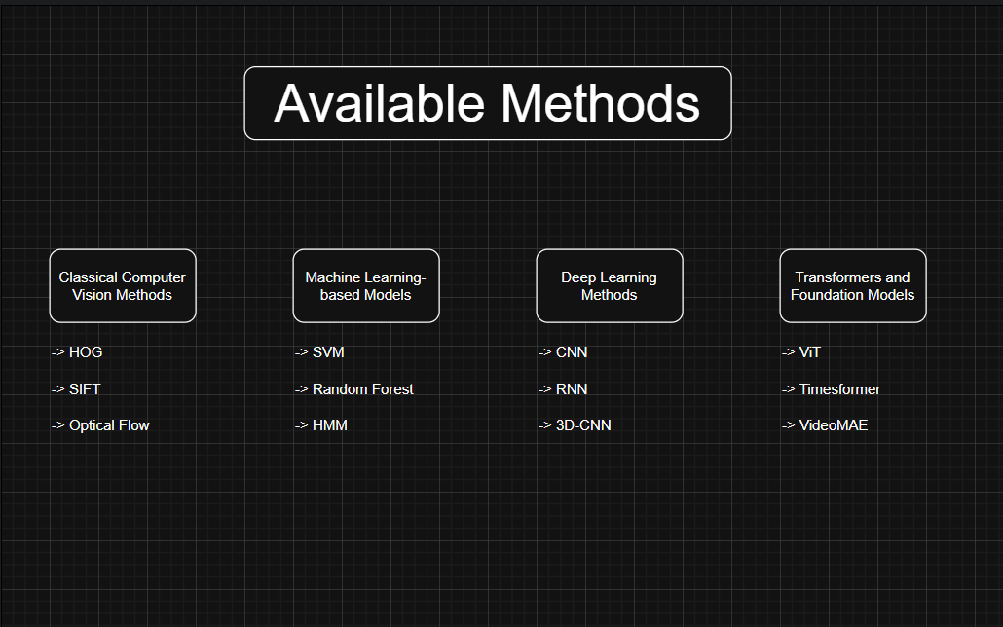

Slide 4
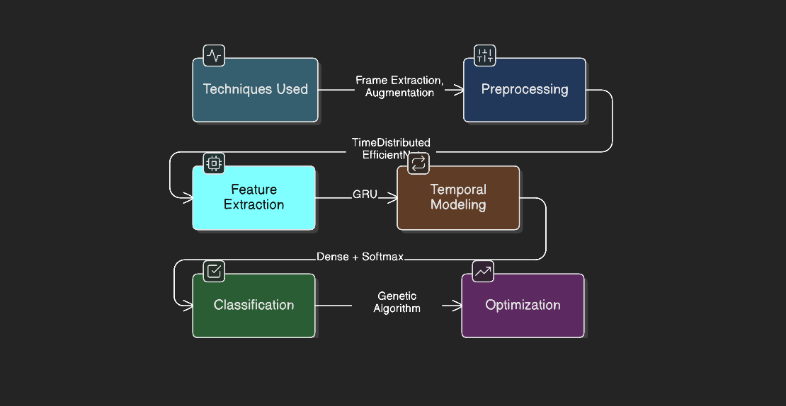
Method Used – CNN + RNN
Fine tuning EfficientNet

Slide 5
Future Scope
Integrate the video understanding pipeline with object detection models (e.g., YOLO) to enable simultaneous action and object recognition.
Deploy the combined system on CCTV infrastructure for real-time scene monitoring and automated event detection.
Extend functionality to identify critical incidents, such as traffic accidents, unusual behavior, or safety violations.
Optimize for edge deployment, allowing low-latency inference on surveillance or embedded devices.
Expand applicability to domains like public safety, industrial monitoring, and autonomous systems for intelligent visual analytics.

Slide 6
Team Details
Vidit Srivastava ( E23CSEU0903 )
Batch-31
GitHub Repo: https://github.com/CORNYBUG2/Real-Time-Cricket-Shot-Classification-and-Automated-Commentary.git

